Slide 1
SBERT for Large-Scale Real-Time Transcriptional Understanding
Designing a performant, modern conversational analysis model with SBERT
Jason Shen

Slide 2
Background
Important conversations happen at many different scales.
Small
In one-on-one or small group settings (e.g., therapy sessions, simple support calls).
Medium
In environments such as parliamentary debates or team-based, goal-driven operations.
Large
During emergencies or widespread incidents (e.g., disaster relief hotlines), thousands of utterances flow in simultaneously. Here, prioritizing the most urgent, relevant information in real-time becomes not just useful, but essential for saving lives.

Slide 3
Smaller scale
Two CMU startups
1. Zetlkast: AI-Powered Real Estate Phone Agent
Industry: Real estate—where client discovery, lead capture, and appointment-setting happen almost entirely by phone.
Agents often miss calls from potential high-value clients due to volume or being unavailable - these calls are answered by the AI phone agent. However for highly prioritized client calls, a human would want to take over in real time.
2. Caseflood.ai: AI Law Firm Phone Agent (raised >3M @ YC)
Industry: Legal services—potential clients call in, often during stressful or urgent situations.
Lawyers can’t answer every call live. Calls are currently transcribed and analyzed in bulk after they finish, using LLMs to decide callback priority. This often delays responses, causing loss of high-value cases.

Slide 4
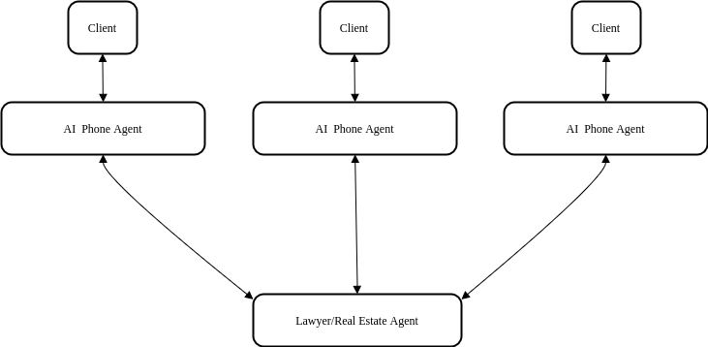
Current Approach: All missed incoming calls are handled by AI phone agents, then analyzed after the call (with LLMs) to determine callback priority depending on importance.
Problem: In many service industries, requiring call back can mean the difference between landing a client or losing them to a competitor. Agents/Lawyers want to be given real time notifications to take over high priority calls.

Slide 5
The same problems but on a much larger scale
Disaster Relief Hotline During natural disasters (floods, hurricanes, wildfires), emergency hotlines receive thousands of simultaneous calls and messages.
Challenge: Dispatchers are overwhelmed. Most calls are urgent, but still need to be prioritized—how do you surface those in time?

Slide 6
Current approaches:
Redundancy Detection: Pattern recognition flags (via keywords/geolocated data) duplicate incident reports, focusing on unique emergencies.
Keyword Parsing:
tf-idf topic detection, keyword spotting (“chest pain”)
Structured Protocols (e.g., THRIVE): AI-assisted dashboards help dispatchers document threat level, resources, and case details
annepalli B S Ruthvik. "Disaster Preparedness Through AI-Based Medical Emergency Detection." Journal of Clinical Case Reports, Medical Imaging and Health Sciences, 9(2), 2025. DOI: 10.55920/JCRMHS.2025.09.001377 This article examines how AI-powered systems enhance disaster preparedness and emergency response by analyzing real-time data, optimizing resource deployment, and improving communication through automated call management and chatbots. It highlights case studies, such as Arlington County’s use of AI to handle non-emergency calls, which frees up human operators for critical emergencies and streamlines overall response efficiency "Artificial Intelligence and the Emergency Services Sector: Case Studies." American Public Works Association (APWA), March 2024 This report presents case studies of AI integration in emergency services, including cloud-based contact centers that manage non-emergency calls, enabling emergency communications centers to focus on urgent incidents. The document details real-world deployments, such as wildfire detection and medical triage, illustrating how AI tools can improve operational efficiency and early threat identification in disaster response scenarios

Slide 7
Existing Framework
For Large-Scale (High Volume) Applications
Convokit (collection of TF-IDF, bag-of-words, keyword parsing approaches):
Strengths:
Highly efficient for clustering and topic grouping across huge numbers of utterances
Designed for batch processing and statistical analysis at scale
Weaknesses:
Outdated: Relies on heavy text preprocessing (stopword removal, token normalization)
Limited semantic understanding—misses nuance, context, and intent
Poor results at small scales or with complex, context-dependent conversations

Slide 8
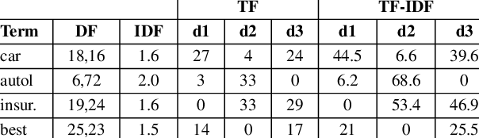
Tf-idf + SVD (Convokit’s Core Approach)
Term Frequency–Inverse Document Frequency (tf-idf):
Measures how important a word is in a document relative to a larger collection (corpus).
Term Frequency (TF): Counts how often a word appears in a document.
Inverse Document Frequency (IDF): Downweights common words that appear across many documents.
Efficient tf-idf requires preprocessing: Filtering Out “Stopwords”:
Common words (e.g., “the,” “and,” “is”) are removed, as they add little meaning.
Token Normalization:
Words are converted to lowercase, stemmed, or lemmatized (e.g., “running” → “run”).

Slide 9
Start with the tf-idf Matrix:
Rows = documents
Columns = unique words
Values = importance of each word in each utterance
Apply SVD (Single value decomposition)
Decomposes the matrix into three parts: M = U Σ Vᵗ
U: Maps documents to topics (importance score of each topic in each document)
Σ : Strength/frequency of each topic (diagonal matrix of singular values)
Vᵗ: Maps topics to words (words that compose the topics)
Keep only the top k largest singular values in Σ (the most “important” topics).
This projects the original data into fewer dimensions—each utterance is now described by a handful of topic scores (which can be thought of as clusters of words that often appear together), not thousands of word counts.

Slide 10
TF-IDF + SVD approach is highly performant for applications corpus size utterance pools must be processed in real time (100,000+ utterances)
What’s Missed?
Nonlinear Relationships:
Semantic patterns where the importance of a word or topic depends on the interaction between words, not just their presence.
Example:
not good” vs. “good”—SVD treats “not” and “good” separately, missing the fact that together, they reverse the meaning.
Idioms or sarcasm, where meaning depends on specific combinations or order of words (“break a leg!”).

Slide 11
The Naïve LLM Approach
How It Works
Directly prompt a large language model (LLM):
For each call or utterance, send the full text to the LLM with an instruction like “What is the main topic of this conversation?”
No preprocessing or domain adaptation:
Relies entirely on the LLM’s general understanding and reasoning.
Performance Issues
High Latency:
Each LLM call takes 1/2–2 seconds or more (especially during heavy load such as disaster relief).
Not suitable for real-time or high-volume environments (e.g., live triage).
Scalability Concerns:
Processing thousands of calls in parallel quickly becomes expensive and slow.
Cloud-based LLM APIs can bottleneck under heavy load.

Slide 12
current state
 | Convokit (Classical NLP) | Naive LLM Approach
Accuracy | Weak; no meaningfulness with smaller utterance pools Unable to handle nonlinear correlations | High; captures deep semantic meaning
Efficiency | Efficient; Optimized for high throughput (+100,000 utterances) | Heavy; requires cloud compute. Low throughput Slow, not suitable for latency dependant tasks. Overqualified for simple topic detection tasks
Adaptability | Weak; requires custom preprocessing of utterances to tune for specific use-cases | Moderate to High; Prompt engineering or fine-tuning

Slide 13
Goal
Develop: A highly adaptable, efficient, real-time capable approach suitable for cases mentioned. Starting plan:
A variation of BERTopic (corpus analysis tool) for real time use cases:
SBERT-embedding + UMAP Dimensional Reduction + HBDSCAN Clustering
Real-time performance optimization for realtime: Graph approach to SBERT-Embedding Grouping.
With predetermined context: On previously established clusters
Without predetermined context: with stop word filtering

Slide 14
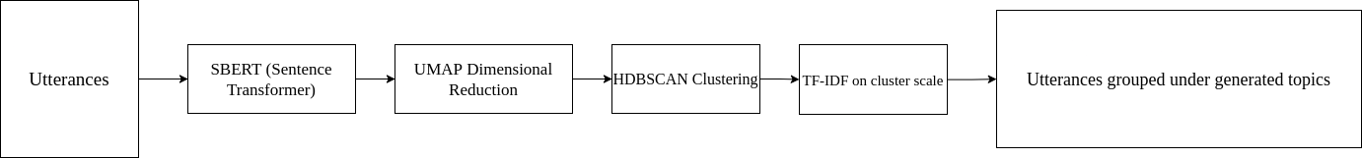
Standard BERTopic pipeline:

Slide 15
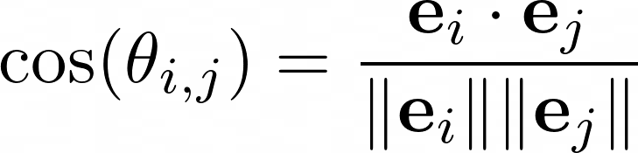
where e_i is a 768-dimensional vector for utterance m_i, which encapsulates dense semantic and topic information.
Cosine similarity between 2 embeddings:

Slide 16
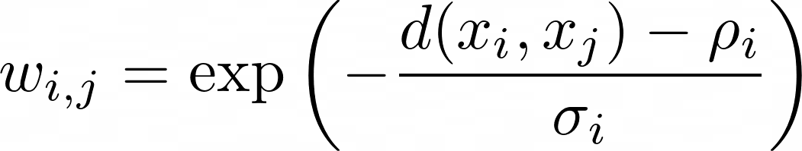
UMAP - Uniform Manifold Approximation and Projection
Reduce high-dimensional (768) embeddings to lower dimensions (5-15) for efficient clustering, while preserving the topic and global structure of the data.
For each point, find its k nearest neighbors. Construct a weighted graph where the weight of an edge between points i and j reflects the probability that j is a neighbor of i.
d(x_i​,x_j​): Distance between points i and j
ρ_i : Distance to the closest neighbor
σ_i: Smoothing parameter based on local density

Slide 17
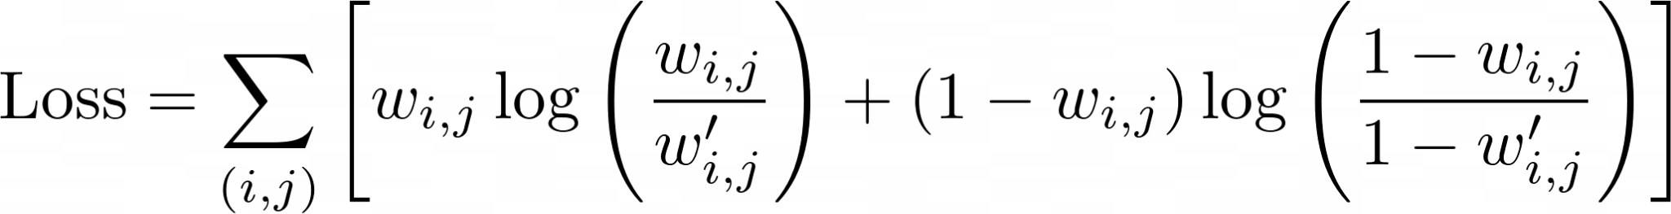

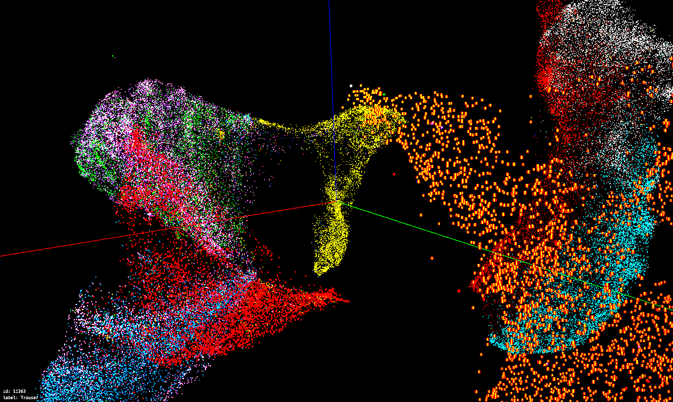
Low-Dimensional Embedding Initialization
Start with a random layout (e.g., 2D or 10D vectors for each point).
Cross-Entropy Optimization
Optimize the layout by minimizing the cross-entropy between the high-dimensional graph and the low-dimensional graph.
The goal is to preserve the probability of connections (local structure) as much as possible.
HDBSCAN Clustering
Clusters points by density and distance -> Topics
Automatically determines the number of clusters.
Fine-tunable
Is the Edge weight in the low-dimensional embedding
Image from UMAP

Slide 18
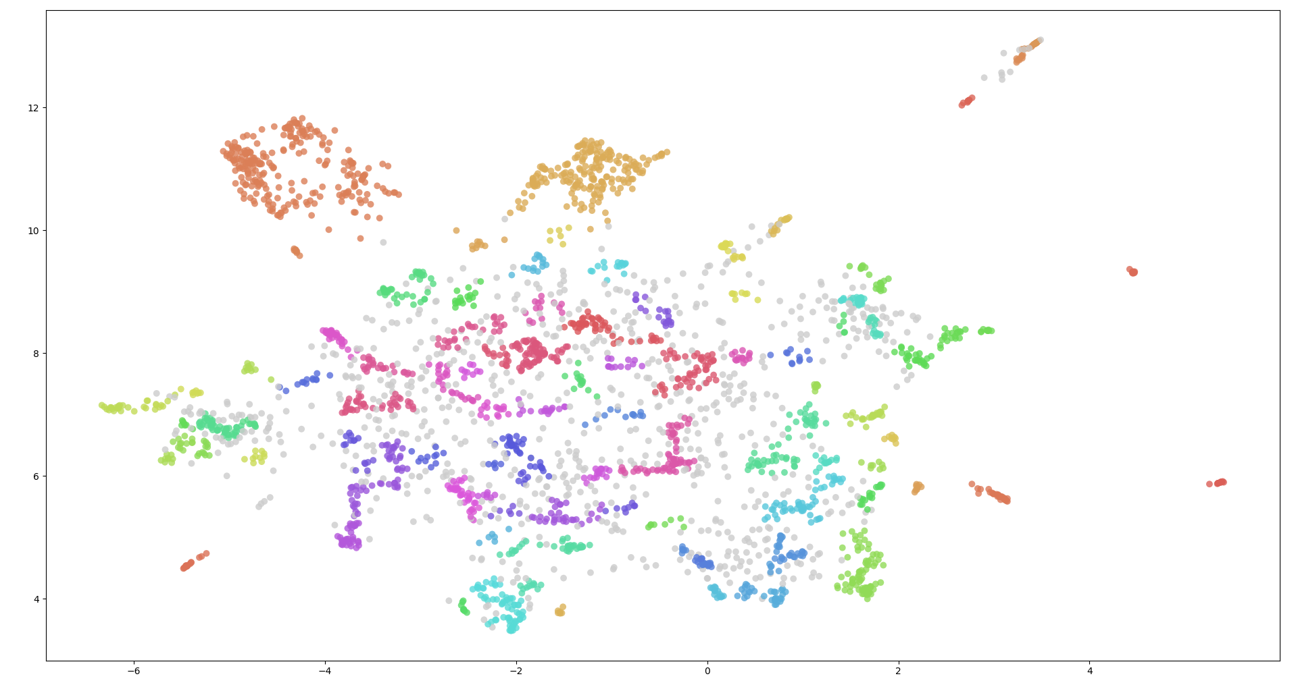
c-tf-idf
Used to assign topic information to clusters automatically.
-> tf-idf treating clusters as units instead of utterances.
2D UMAP + HBDSCAN + c-tf-idf on ~3000 British Parliamentary remarks (subset of data set provided by Convokit Corpuses)
Filtered Topics:
Health/NHS: nhs, patient, hospital, funding, care, …
Education: school, teacher, pupil, university, exam, …
EU: brexit, agreement, eu, trade, border, …
Climate: climate, carbon, emission, renewable, policy, …
Economy: economy, job, growth, investment, wage, …
Immigration: immigration, border, visa, asylum, policy, …
Defence: defence, armed, security, military, nato, …
Transport: transport, road, railway, bus, project, …
Welfare: benefit, welfare, payment, support, poverty, …
Housing: housing, tenant, council, planning, property, …

Slide 19
Adding Real-time capability to BERTopic
There is no current implementation of BERTopic suitable for real-time operations
Standard BERTopic is batch-oriented; not optimal for streaming data.
UMAP (for dimensionality reduction) is computationally expensive if recomputed on every new utterance.
Recall our goal: enable efficient, accurate topic assignment as each new utterance arrives in real-time.

Slide 20
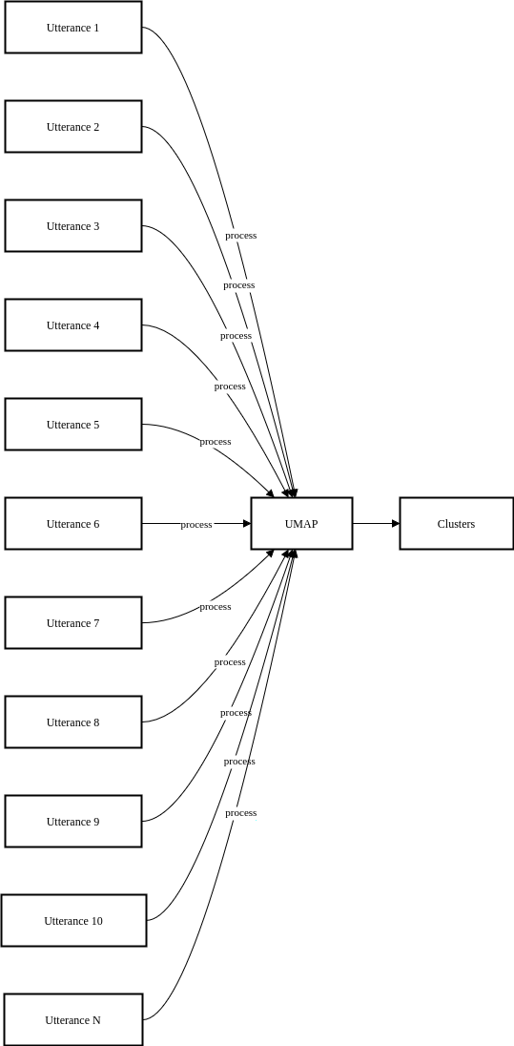
The UMAP Bottleneck
UMAP reduces high-dimensional embeddings (SBERT output) for clustering. Problem: UMAP must process all utterances together; adding even one new point requires a full recompute.

Slide 21
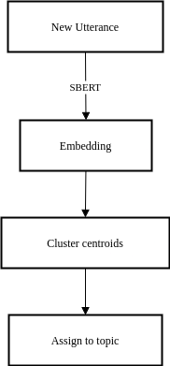
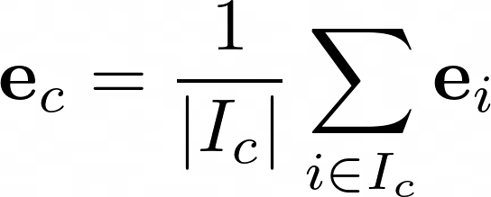
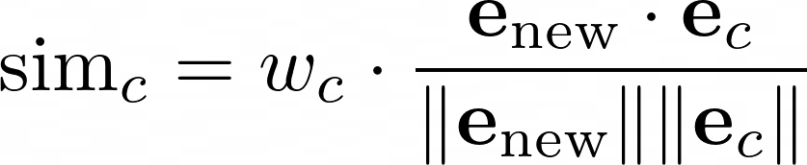
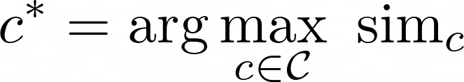
Precompute Clusters
For domains with prior data: Run UMAP + HDBSCAN on the historical utterances. Each cluster cc contains utterance indices I_c
For each cluster c with utterance indices I_c, compute the average SBERT embedding (centroid):
On new utterance: Compute SBERT embedding and Assign to cluster
This operation is expected to take less than 5ms on consumer grade hardware:

Slide 22
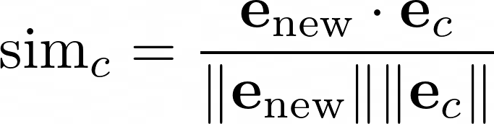
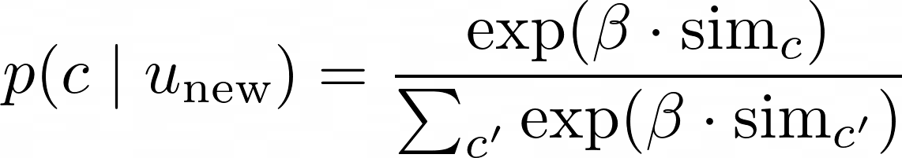
Assignment
Given a new utterance embedding e and cluster centroids e_c
With domain bias,
Convert similarities to probabilities using softmax (with temperature beta):

Slide 23
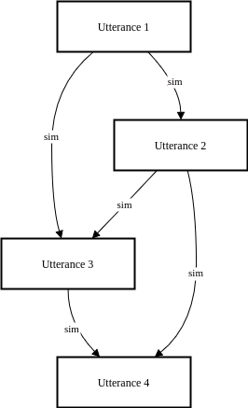
For applications with no prior utterance data available: Utterance-Level Graph Construction (Cold-Start Approach)
Connect each new utterance to its k existing utterances (using cosine similarity in embedding space).
Use Louvain Algorithm to cluster utterances:
Initialize each node as its own community.
Repeat:
For each node, evaluate the gain in modularity from moving it to each neighbor community.
Move the node to the community that yields the highest modularity gain (if positive).
When no more improvements, aggregate nodes in the same community into super-nodes, and repeat on the induced graph.
Stop when modularity cannot be improved.
Output: a set of clusters (communities).

Slide 24
Summary: Adding Real-time capability to BERTopic
UMAP is still expensive to compute for every utterance added (requires the recomputation of all utterances to lower dimension)
For domains with prior utterance data, compute umap utterances beforehand. Treat clusters as nodes with an average high dimensional SBERT-embedding (not UMAP) in a graph of high dimensional representative embeddings for each topic cluster produced by UMAP. For real time utterances, compute weighted cosine-distance between high dimension SBERT embedding and topic embedding to classify into pre-established topics. This can be done in 5-10 ms per utterance depending on transformer size. Edge bias weights are adjusted to suite domain needs (more or less leniency/bias towards certain topics)
UMAP is recomputed every 1000 utterances added (this value is empirically decided): We get rid of c-tf-idf, use stratified random cluster sampling to call large language models for high quality labeling for each cluster.

Slide 25
Expected Performance Comparison
 | Convokit (Classical NLP) | Naive LLM Approach | Real-Time Adapted SBERT
Accuracy | Weak; no meaningfulness with smaller utterance pools Unable to handle nonlinear correlations | High; captures deep semantic meaning | Good; embeddings capture semantic and topic meaning
Efficiency | Efficient; Optimized for high throughput (+100,000 utterances) | Heavy; requires cloud compute. Low throughput (500+ ms latency for a new utterance) Overqualified for simple topic detection tasks | Efficient, new utterances are computable on consumer level hardware at low latency (sub 10ms)
Adaptability | Weak; requires custom preprocessing of utterances to tune for specific use-cases | Moderate to High; Prompt engineering or fine-tuning | Moderate. Cluster weight bias, temperature can be fine tuned to specific needs

Slide 26
Model Evaluation
Benchmark against real-estate call transcript database (thanks to Zetlkast) (LLM-prelabeled)
1982 record calls labelled as below with call-back priority:
C1: New Inquiry (nonspecific property) - High
C2: Showing (specific property) - High
C3: Offer - Moderate
C4: Follow-up - Moderate
C4: General Question - Low
C5: Vendor - Low
C6: Complaint - Low

Slide 27
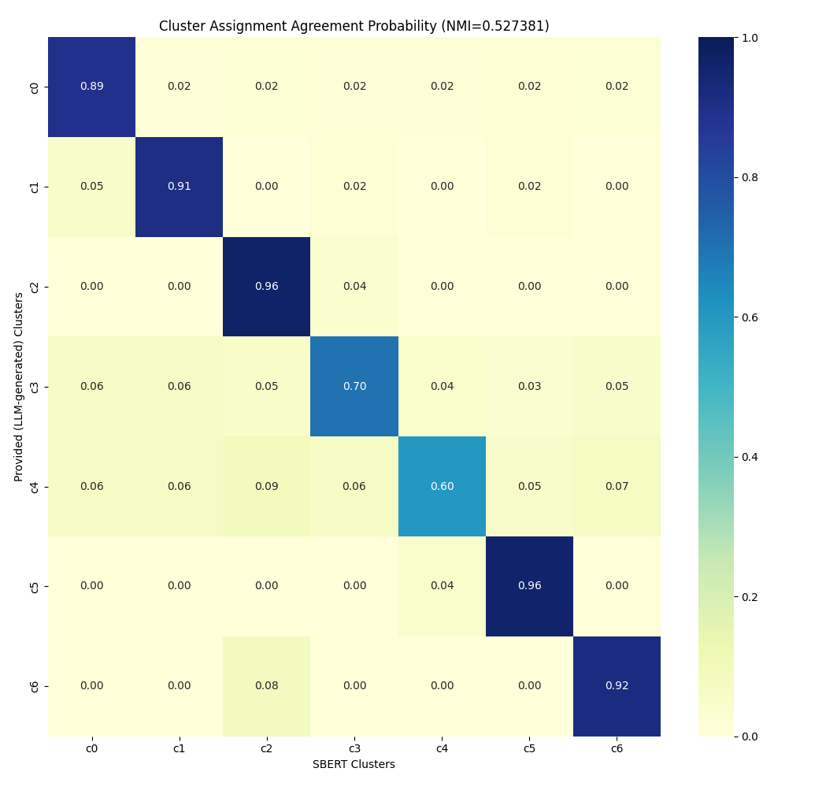
Realtime SBERT vs. LLM (GPT-3.5 Turbo)
Base UMAP clustering done on training set of 1000 data points.
Cluster assignment done with fine tuning favoring high priority topics (c1 & c2).
Due to comparison with LLM categories - No soft-assignment - assignment is the highest softmax topic
C1: New Inquiry (nonspecific property) - High (325)
C2: Showing (specific property) - High (55)
C3: Offer - Moderate (56)
C4: Follow-up - Moderate (190)
C5: General Question - Low (320)
C6: Vendor - Low (25)
C7: Complaint - Low (12)

Slide 28
Good at… Identifying specific topics (i.e. requests for showings, new inquiries about areas, etc.) Bad at… Divergent/general topics - no specific semantic rule
Can be mitigated with
Use of clusters with specific topics
threshold distance for casting nonfits as outliers

Slide 29
Performance
1. Convokit Framework (ExpectedContextModel) (tf-idf + svd)
- Latency: >1ms per utterance (Intel i7-9750H)
- Factors: persistent embeddings, not GPU-accelerated (default implementation)
2. LLM Prompt Engineering Approach
- Latency: ~500-2000ms per utterance (if realtime/not batch)
- Factors: OpenAI API with GPT-3.5 Turbo Instructor (200 tokens)
3. Realtime SBERT Adaptation
- Latency: ~5-10 ms per utterance
- Factors: (model: mpnet-base, RTX 5000 Workstation GPU)

Slide 30
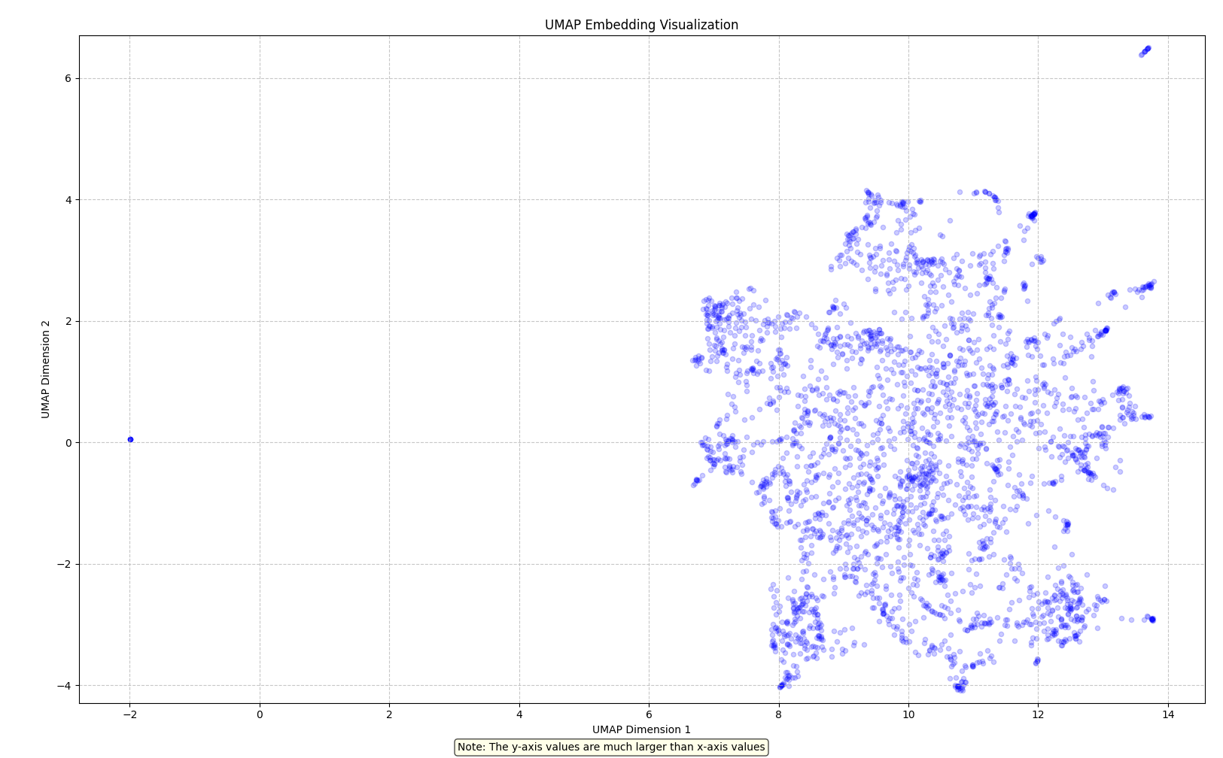
British Parliament Utterance Visualization (convokit corpus)
100,000+ utterances (5000+ topic labels)
Plot of high density areas
(not individual utterances)

